Slide 1
US Powerboating Safe Powerboat Handling / Safety and Rescue Boat Handling Day One

Slide 2
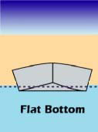
Hull Types and Characteristics
Flat Hulls [planing] SPR p.4
Easily get on a plane at high speeds
Designed for calm, flat water
Not very stable
Excessive slide when maneuvering

Slide 3
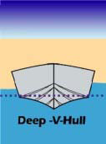
Hull Types and Characteristics
Deep V [planing] SPR p.5
Similar to flat bottom but designed to cut through water
Good steering ability at high speeds
Perform well in waves in speed; tend to roll at rest

Slide 4
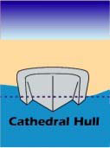
Hull Types and Characteristics
Cathedral Hull [planing] SPR p.5
Two or three v-shapes forward, flat in back
Good stability at rest and at speed
Rough at speed in waves
Usually have a lower freeboard

Slide 5
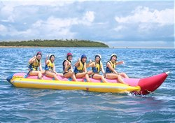
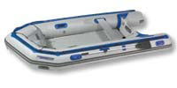
Hull Types and Characteristics
Soft-Inflatable Hulls [planing] SPR p.5
Poor driving ability (excessive slide)
High stability
High load capacity
Very wet ride

Slide 6
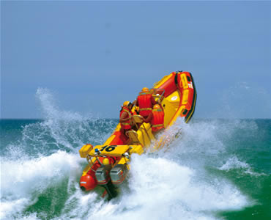
Hull Types and Characteristics
Rigid Inflatable Hulls [planing] SPR p.6
Rigid vee-bottom
High stability
High load capacity
Exceptional seaworthiness in rough water

Slide 7
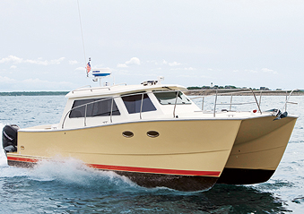
Hull Types and Characteristics
Multi-Hulls [planing] SPR p.6
Resist rolling
Good steering ability at speed
Large turning radius
Shallow draft

Slide 8
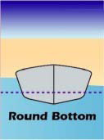
Hull Types and Characteristics
Round Bottom [displacement] SPR p.4
Glide through water efficiently
Speed is limited by length (hull speed)
Usually have keel or chine for stability
Good load bearing capability

Slide 9
Parts of the Boat SPR p.11

Slide 10
Propellers SPH SPR p.8
How propellers work
Thrust
Rotation [right-screw most popular]
Side force (prop walk)
More noticeable in reverse – esp. on fixed propeller
Diameter
Pitch
Distance propeller would move in one revolution if turning in solid material
ie 17” pitch propeller would move 17” inches
Propeller size = diameter + pitch
Smaller diameter + higher pitch used on high-speed boats
Larger diameter + lower pitch used on slow-speed boats
Stainless steel vs. Aluminum
Linkage p.16

Slide 11
Maneuvering Concepts
Uncontrollable forces affecting a boat
Wind p.44
Windage causes bow to fall off and boat to drift sideways
Increased freeboard = increase windage effect
Windage affects your turning arc
Current
Will move boat along as if on a conveyor belt
Size, shape, etc. do not matter – current effects all things equally
Yay for Lake Michigan! (mostly)

Slide 12
Maneuvering Concepts
How boats turn
Directed Thrust p.41
Outboards, stern drives and jet drives
When a propeller is turned at an angle, its thrust is directed at an angle, which turns the boat
If propeller is not rotating then no thrust, so no steerage
Rudder p.41
Boats with a fixed propeller use a rudder to direct the flow of water
Water flowing over the rudder creates lift (sideways force) and turns the boat
No water flowing over the rudder = no steerage
Pivot Point p.44
In forward, a boats pivot point is located 25% to 40% aft from the bow
Always steer the pivot point along the path you want to steer!
Where is the pivot point on a boat in reverse?

Slide 13
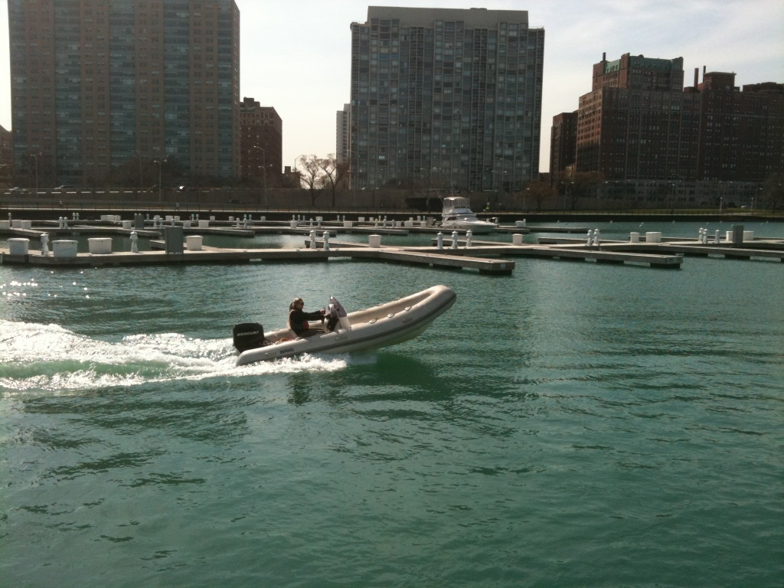
Maneuvering Concepts
Planning hulls behave like displacement hulls at low speed
At a certain speed, the hull goes through a transition stage called semi-displacement as it climbs the face of its bow wave p.47
Once the boat moves over the top of its bow wave, it levels off and begins to plane
Where is the most optimum fuel consumption for a planing hull?
Just as the boat has come comfortably on a plane

Slide 14
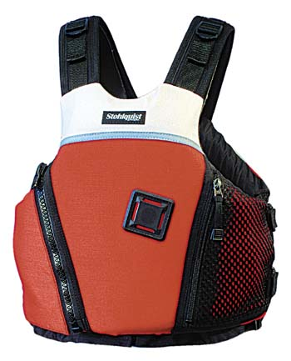
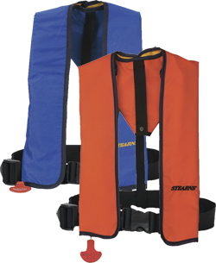
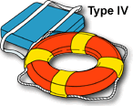
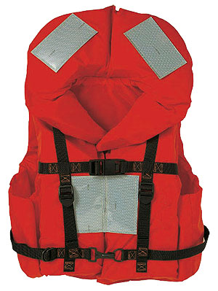
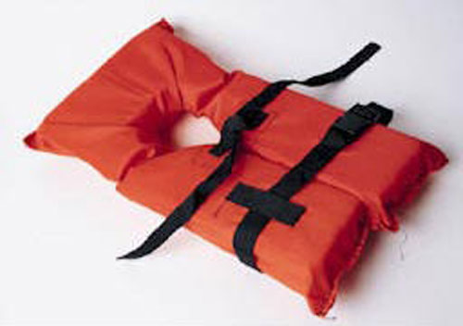
Safety Equipment SPR p.83
PFDs
Five types of PFDs
Type I – Offshore Life jacket
22 lbs of buoyancy for adults / 11 lbs for children
Will turn unconscious person face-up
Type II – Near-Shore Life Vest
Min. of 15.5 lbs for adults / 11 lbs for children
Will turn some unconscious people face-up
Type III – Flotation Aid
Buoyancy the same as Type II
Will not turn unconscious person face-up
Most common
Type IV – Throwable Device
Type V – Special use Devices
Inflatable vests, etc.
No inherent buoyancy
Must be worn!

Slide 15
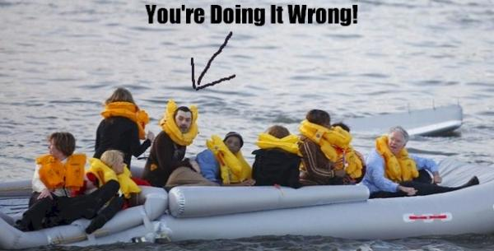
Safety Equipment
PFDs
Proper use of PFDs is integral!
Should fit snugly but still allow movement
If you can pull it up around your head on land, the same thing will happen in the water
Any PFD with a tear or hole in it is no longer Coast Guard approved

Slide 16
Safety Equipment
Federal Requirements for boats under 26ft
One life jacket for each person on board. Must be readily available.
Children under 13 MUST wear a lifejacket while underway (on any size vessel) unless below decks or in an enclosed cabin
Over 16ft – one Type IV throwable device
Sound producing device p.85
Air horn, whistle, manual horn, etc.
Fire extinguisher p.85
Under 26ft – one B-I
A – combustible material (wood)
B – flammable liquids (gas)
C – electrical (wiring)
D – combustible metals (magnesium)
Under 16ft - Visual distress signals if used at night p.84
16ft up – MUST carry approved day/night visual distress signals

Slide 17
Safety Equipment
Recommended Requirements
Anchor + rode
VHF Radio
Knife
First Aid Kit
Spare parts / tool kit
Oars
Hand bilge pump
Tow line / spare line

Slide 18
Safety Equipment
Rescue Gear
Boat hook
Throw line
Bridle for towing + tow line
Spare boat parts
Line, shackles, pins, blocks, sail tape, etc.

Slide 19
Registration Information p.82
Hull Identification Number
Registration numbers and form
Boat must be registered in its state of principal use or federally documented
‘IL’ numbers must be displayed on each side of the bow in letters at least 3” high
Registration must be aboard vessel at all times
Max capacity plate
Displays maximum weight and # of passengers (# of passengers takes precedence)
Displays maximum horsepower engine (on outboard)
Displays maximum weight capacity of all passengers, engine and gear
Capacity equation: L x B / 15

Slide 20
Some State Specific Info
Marine Heads: No marine head (toilet) on any watercraft used upon waters of this state may be so constructed and operated as to permit the discharge of any sewage into the waters directly or indirectly.
Battery Covers: Storage batteries shall be provided with suitable supports and secured against shifting. Batteries shall be equipped with nonconductive shielding means to prevent accidental shorting.
Unlawful Operation at Night: No person shall operate a personal watercraft or a specialty prop craft between the hours of sunset and sunrise.
Age of Operator:
1. No person under 10 years of age may operate a motor boat.
2. Persons at least 10 years of age and less than 12 years of age may operate a motorboat only if:
a. they are accompanied on the motorboat and under the direct control of a parent or guardian, or a person at least 18 years of age designated by a parent or guardian.
3. Persons at least 12 years of age and less than 18 years of age may operate a motorboat only if:
a. they are accompanied on the motorboat and under the direct
control of a parent or guardian or
b. a person at least 18 years of age designated by a parent or guardian or
c. such motorboat operator is in possession of a Boating Safety Certificate issued by the Department of Natural Resources, Division of Education or a valid certificate issued by another state, a province of the Dominion of Canada, the United States Coast Guard Auxiliary or the United States Power Squadron.

Slide 21
Engine Information SPR p.13
Outboards
Engine mounted on transom of boat
2hp – 350+ hp
2-stroke or 4-stroke
2-strokes fire once every revolution of the crankshaft
Power / intake-exhaust; compression
4-strokes fire once every 2 revolutions of the crankshaft
Intake – compression – power - exhaust
2-strokes use a gas/oil mixture
4-strokes use straight gas (oil is in the crankcase)
Traditional 2-strokes are becoming obsolete
Bad for the environment
Less fuel efficient

Slide 22
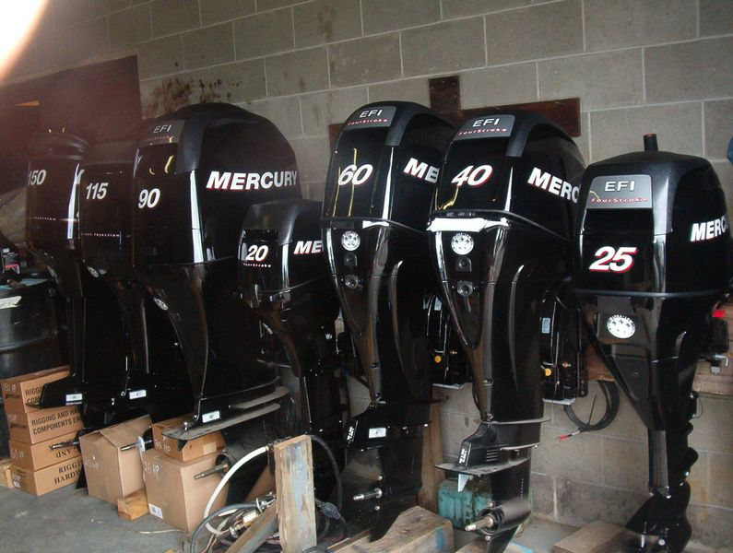
Engine Information
Outboards
Variable shaft lengths
Can be tilted all the way up or removed for storage

Slide 23
Engine Information
Parts of an outboard engine SPR p.14

Slide 24
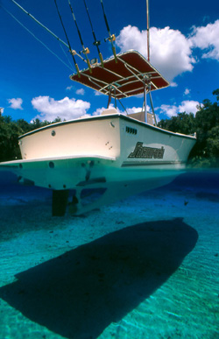
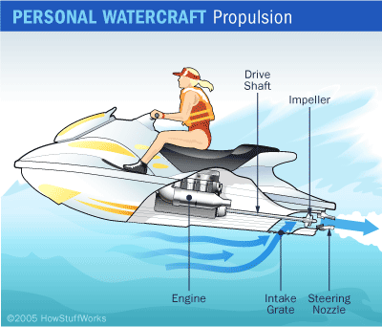
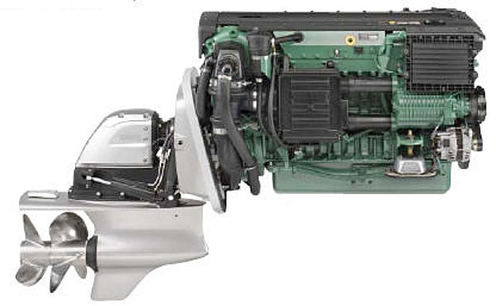
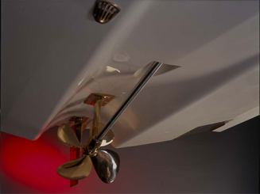
Engine Information
Inboards SPR p.20 and p.41
Engine mounted inside boat
Gasoline or diesel
Diesel is safer than gas – less risk for fire
Gas inboards MUST have a backfire flame arrestor
3 types of drive options:
Fixed propeller drives
Prop shaft passes through bottom of boat
Steered by a rudder
Stern drive (I/O)
Engine mounted inside and the power train goes through transom to the stern drive
Stern drive has tilt and trim similar to an outboard
Jet drive
Impeller accelerates water through a nozzle to produce propulsive thrust

Slide 25
Engine Information
Proper fueling procedures SPR p.18 & 25
Common fueling mistakes
Forget to vent the jerry can
Nozzle not tightly attached to jerry can
Overfilling
Pouring one tank straight into another without a funnel or nozzle
Pouring fuel into a deck fill that is NOT for fuel

Slide 26
Engine Information
Proper start-up procedures for gas engines SPR p.16 & 21
Inspect all hoses and wires
Check fuel, oil and transmission fluid levels
Run blower for 4 min (inboards)
Lower engine into water (outboards and I/Os)
Pump fuel primer bulb until firm, open vent
Ensure that gear shift is in neutral
Attach stop switch (kill switch)
Pull cord / turn key to start
Use choke and adjust idle as needed until running smoothly
Once running, MAKE SURE THERE IS A STREAM OF WATER FLOWING FROM THE INSPECTION OUTLET
Check gauges

Slide 27
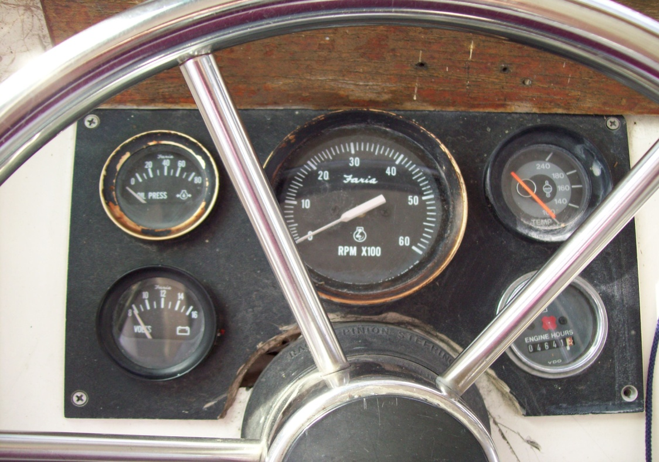
Engine Information
Gauge Guidelines
Hour Meter
Volt Meter –
12+ volts
Oil Pressure –
MINIMUM of 20 PSI
RPM –
MAX Idle RPM of 800
Temperature –
140-160 is normal; 180+ is overheating

Slide 28
Engine Information
Troubleshooting
Fuel – Spark – Compression!
Nothing happens when you turn the key
Spark – is the battery dead? Are you in neutral?
Engine turns over but won’t catch
Fuel – is the engine getting gas? Is there water in the gas? Is the fuel line attached backwards?
STOP SWITCH!
Engine runs fine at idle but kills when at higher RPM
Spark – bad spark plug? Loose spark plug lead?

Slide 29
Pre-Boarding Preparation
Check weather conditions SPR p.29
Not just for today but for yesterday and tomorrow!
Internet
Weather.com
Sailflow.com
Intellicast.com
NOAA.gov
VHF
wx channels – broadcast continual marine forecasts

Slide 30
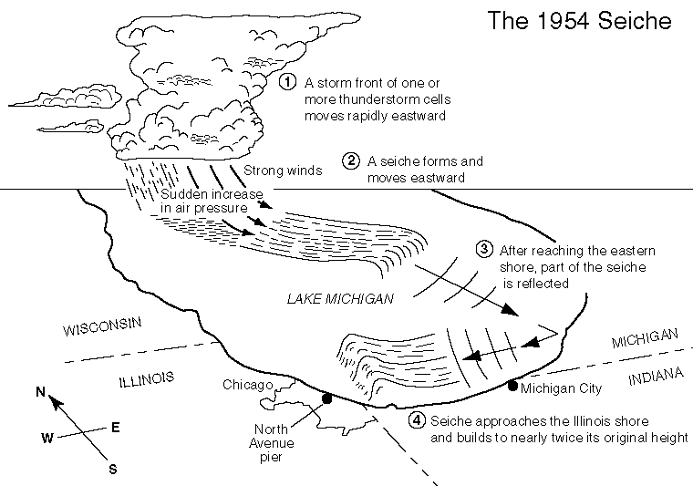
Pre-Boarding Preparation
Understand local weather patterns
Hot city + cool water = onshore breeze (only extends a few miles out)
Cool city + warm water = offshore breeze
Where direction does weather usually come from?
What weather issues will most likely affect you?
Northeastern = cold and wavy
Northerly breeze on hot day = fog
Southwestern = flat and puffy
*what is fetch?
What is a seiche?

Slide 31
Pre-Boarding Preparation
Check tides and currents
Not an huge issue on Lake Michigan
Occasional current in mouths of harbors depending on wave/swell direction
To check current, use a current stick or observe motion of water around a fixed object
Belmont is particularly prone to current in the mouth of the harbor when there is an onshore breeze

Slide 32
Pre-Boarding Preparation
File a float plan SPR p.31

Slide 33
Pre-Boarding Preparation
Complete vessel checklist

Slide 34
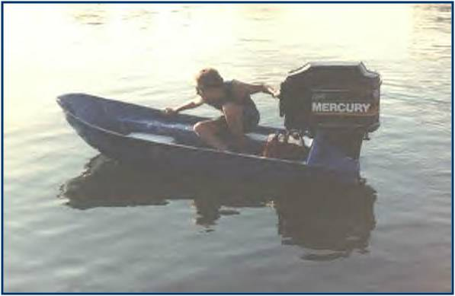
BREAK

Slide 35
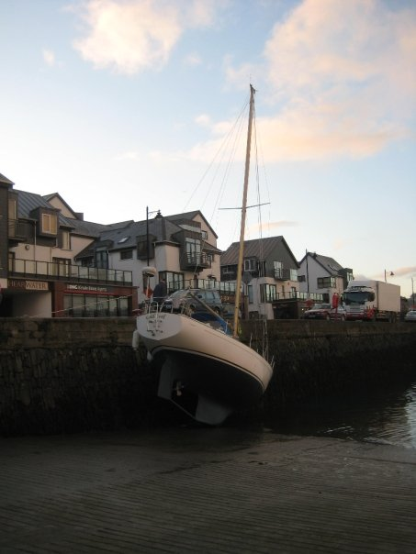
Boat Operation
Departing and returning to a dock
Lynn’s rules of docking:
Approach a dock as fast as you want to hit it.
You will hit a dock eventually. Try to do it when no one else is around.
Feel free to laugh at other’s docking mishaps after you have rendered assistance.
Don’t forget – docking is a spectator sport!

Slide 36
Boat Operation SPR p.54
Departing and returning to a dock (for real)
Wind and current play MAJOR factors into docking. Always plan ahead to account for both.
Try to dock on the leeward side if you are going to be staying for any length of time.
Have lines and fenders ready BEFORE getting to the dock.
Depending on the wind, you should be approaching from anywhere between 20-45 degrees.
You should be able to bring boat to stop at dock without using lines to stop you.

Slide 37
Boat Operation
Departing and returning to a dock
Things to avoid:
NEVER try to stop a boat without using a cleat
NEVER put your body between a boat and a dock - bones are harder to repair than fiberglass!
NEVER do the leap of faith onto the dock
NEVER jump off the bow and pull it in as fast and tightly as you can

Slide 38
Boat Operation
Departing and returning to a dock (video)

Slide 39
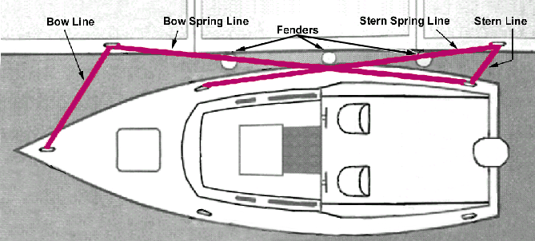
Boat Operation
Departing and returning to a dock SPR p.38
Proper line usage:

Slide 40
Boat Operation
Proper boat storage – At the dock
Engine raised and flushed (well….maybe)
Steering wheel turned so steering arm is enclosed
Lines checked and flemished
Fenders hung at proper height
Battery switched off (if appropriate)
Any gear that was used stowed appropriately
Bilge checked
Garbage emptied

Slide 41
Boat Maneuvering
Slow speed maneuvering
Start, stop, reverse SPR p.40
Minimum control speed SPR p.45 (video)
Pivot turn SPR p.52 & p.59 (video)
Holding position SPR p.46 (video)
Downwind / upwind
Approaching a mooring (video)

Slide 42
Boat Maneuvering
Planing maneuvers
Planing turns
High speed slalom (avoidance turns) SPR p.51
High speed stop (video) SPR p.53

Slide 43
Boat Operation
To the boats!

Slide 44
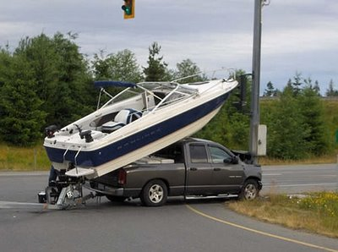
Boat Operation
Proper boat storage – Ashore
Trailer guidelines p.143
Be diligent with checking all aspects of trailer and connection
Don’t settle – if boat isn’t seated properly, redo it
Always remember to raise your engine before driving up the ramp!
Check your tie downs multiple times.

Slide 45
Knots
www.animatedknots.com
Cleat hitch
Bowline
Round turn w/2 half hitches
Sheet bend
Coiling and heaving

Slide 46
LUNCH

Slide 47
Person in the Water
Proper Recovery Technique (SPR p.137)
Yell ‘man overboard’!
Driver immediately turns towards person swinging his propeller away from them
Assign spotter
MOST IMPORTANT PERSON
Throw flotation devices towards PIW
Circle around until able to approach from a DOWNWIND position
Approach PIW on driver’s side and glide to a stop next to him/her [MUST BE IN NEUTRAL GEAR]
Throw a looped rope and attach person to boat
*****turn engine off*****
Assist person into boat and care for

Slide 48
Person in the Water
Proper Recovery Technique (video)

